Slide 1
BASIC NETWORKING
Protocols and Ports

Slide 2

OBJECTIVES FOR TODAY
Understanding the network architecture
Understanding the difference type of protocols and ports
Be able to identify how network communication works

Slide 3



ENGAGE
Server ?
What is
5 MIN
Does server and computer are the same?
Why are computers called servers?
Notes:
Answer:
End Devices (computer, phone, tablet…)
Internet connection (you need to be online)
Network devices (AP, router, modem, switch, RJ45 cable…)

Slide 4
Network Architecture

Slide 5

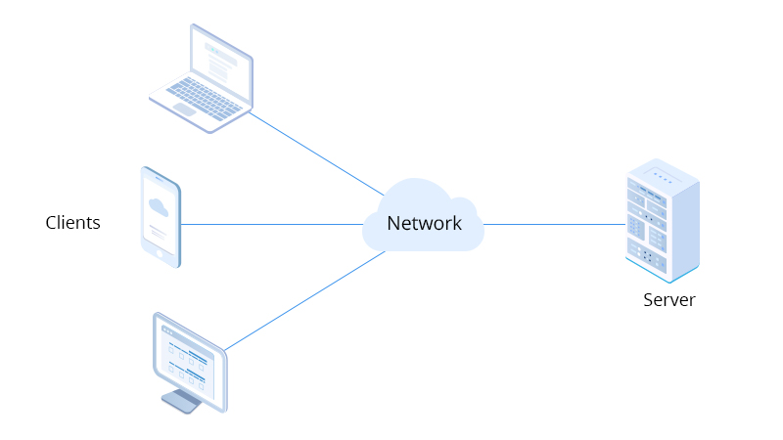
Client Server Architecture
EXPLAIN
10 MIN
In computing terminology, both “client” and “server” refer to computers that are used for different purposes.
In a client-server network, there are a dedicated central server that control the network and a number of clients.

Slide 6
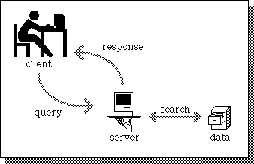
Client Server Architecture
EXPLAIN
10 MIN
A client is a computer that connects to and uses the resources of a remote computer, or server through the network.
A server is the receiving and responding program that processes the requests of the client program and enables the client to execute its actions.
Notes:
Client-server network:
Centralize management
Better protected on a single server
Adding new feature without interrupt
Backup and recover more easily

Slide 7

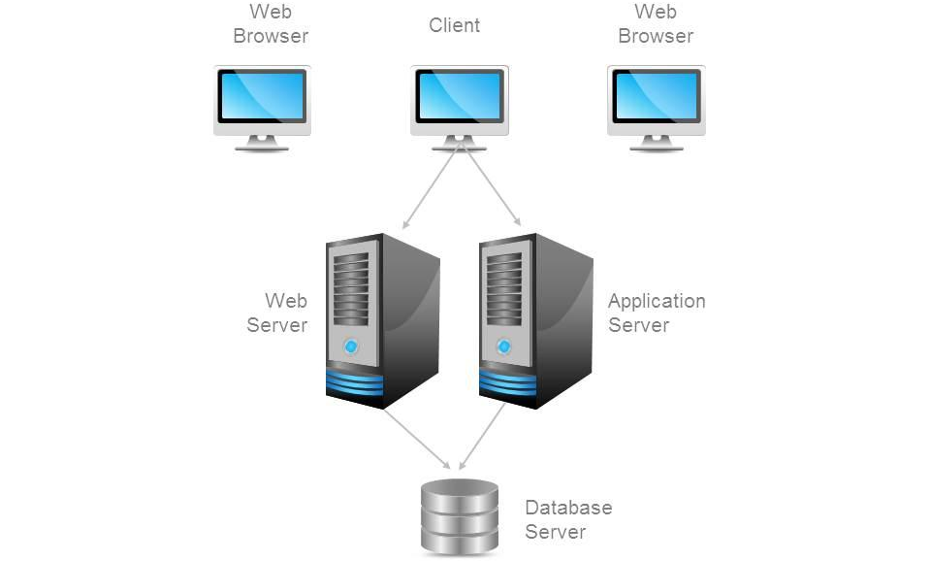
Example of Client Server Architecture

Slide 8
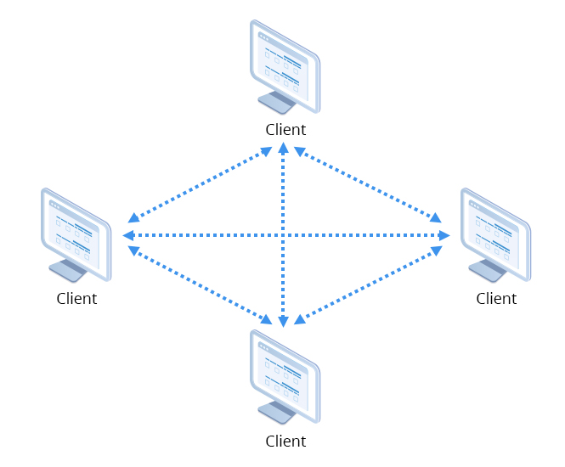
Peer-to-peer (P2P) Architecture
EXPLAIN
10 MIN
Peer-to-peer network, there is no central server controlling the network.
Instead, all computers are connected to one another and share resources such as files, applications, and programs.
Each computer can either be a client or a server.
Notes:
Peer-to-peer network:
File sharing become easy.
Not require expert
New client added easily

Slide 9
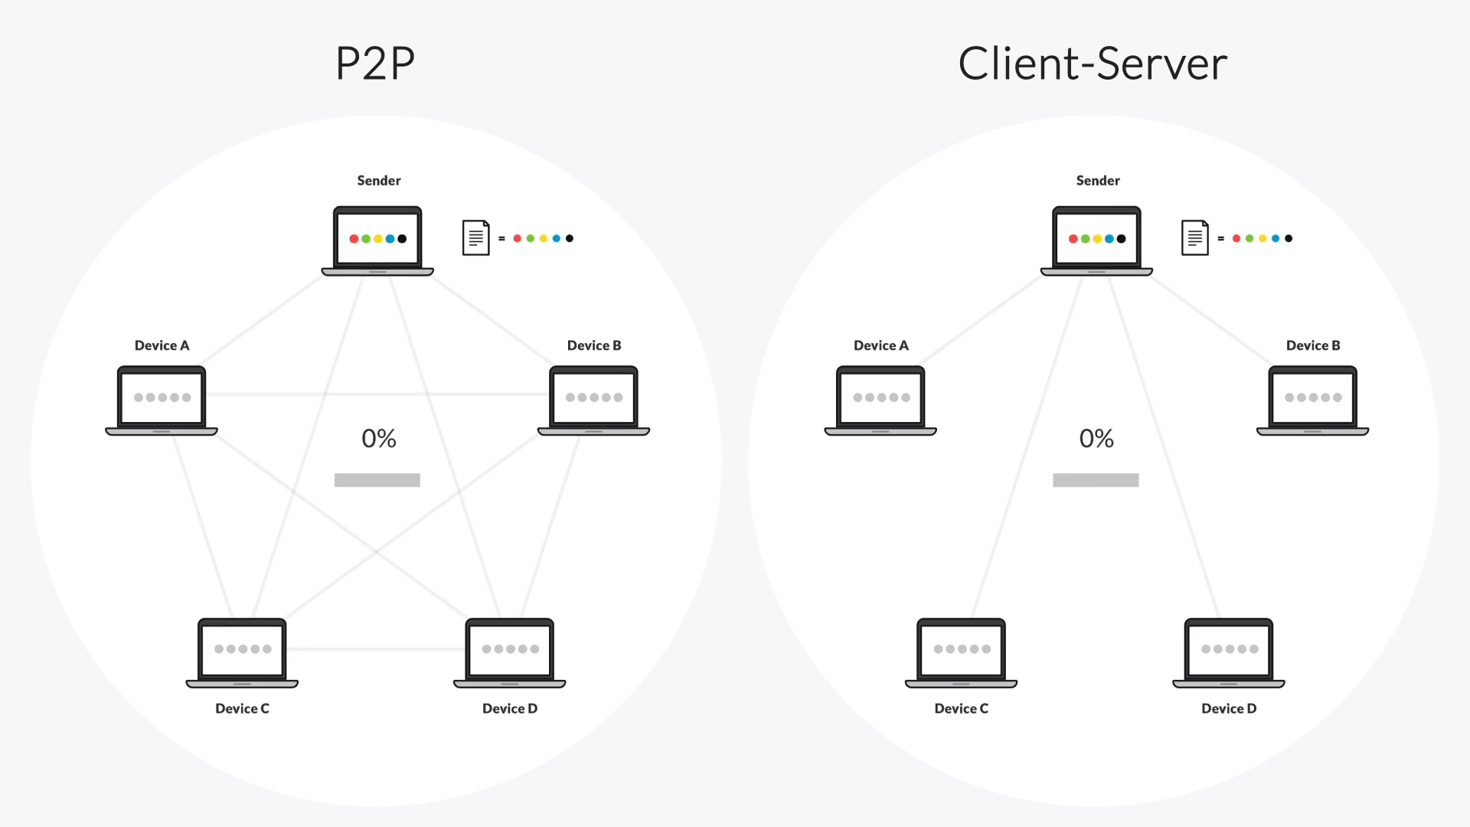
Sharing Files between 2 Architectures

Slide 10
Protocols and Ports

Slide 11

EXPLORE
5 MIN
1. What is port in networking?
2. How are port and protocols related?

Slide 12
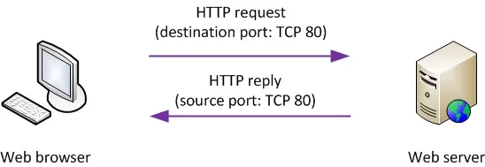
EXPLAIN
What is a port?
5 MIN
A port in computer networking is a logical access channel for communication between two devices.
Each port assigned a number. Most port are reserved for certain protocol.
Ex. HTTP messages go to port 80.

Slide 13
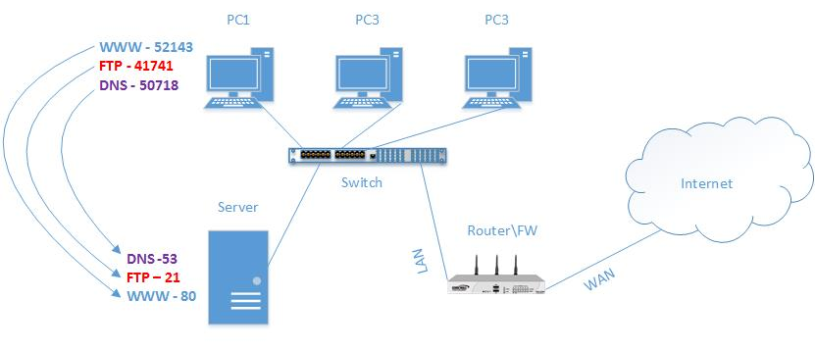
EXPLAIN
What is a port?
5 MIN
Vastly different types of data flow to and from a computer over the same network connection. The use of ports helps computers understand what to do with the data they receive.
Each port is associated with a specific process or service (protocol).

Slide 14
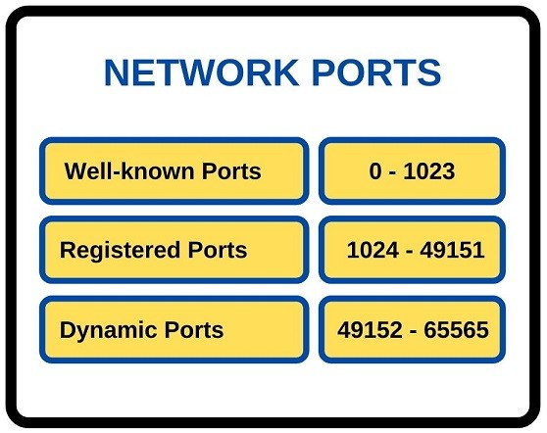
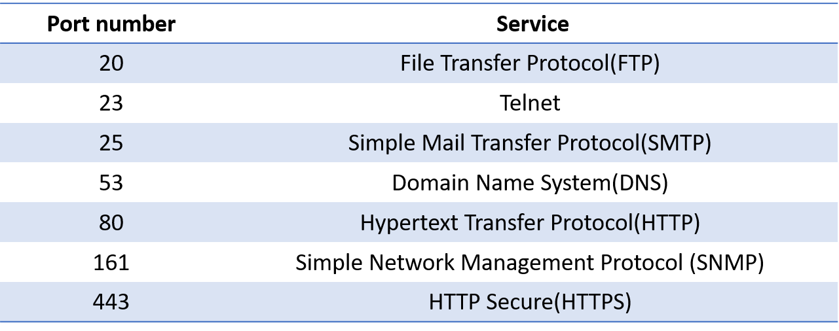
EXPLAIN
The different of port number
5 MIN

Slide 15


